Slide 1
HydraMini
Xilinx 吴天择

Slide 2
内容提要
成果 | 内容
可以进行DNNDK量化和编译的Host 可以运行DPU任务的Pynq | 学习如何在Ubuntu16.04上安装DNNDK及AI环境，学习如何在Pynq-Z2系统上安装DNNDK及加载dpu模块
对Keras、Tensorflow、AI模型训练有一定了解，能修改模型结构或训练方式 | AI基础知识讲解，小车End-to-End模型介绍
学会如何控制小车，收集小车的训练数据 (获得n张训练图片与对应的标签文件) | 讲解小车简单的机械控制原理，控制小车收集训练数据
训练模型并转化保存为pb文件 (能顺利运行模型训练，成功保存.h5文件，能将其转化为.pb文件) | 讲解简单的图片预处理知识，对收集到的图片进行预处理并最终训练，介绍目前主流的AI框架知识
量化编译完成的DPU文件 (能顺利完成decent任务，能成功编译并生成.elf文件) | 讲解DNNDK基础知识，学习如何使用DNNDK工具
使小车完成自动驾驶任务 (能成功生成可执行文件，能顺利运行) | 介绍DNNDK编程接口，在Pynq上运行Inference任务
优化模型，问题解决 | 简单介绍AI模型优化知识，总结分析
手写数字识别任务完成 (能根据教程完成手写数字识别任务) | 尝试在Pynq上复现经典的手写数字识别案例
Notes:
So let’s take a deeper tour of the technology itself
In the past our entire device was just the one engine you see in the middle– that core programmable logic that we invented over 30 years ago ….
Well now that’s just one of multiple engines
First pair of engines you see on the left are the scalar engines, or the Arm processing subsystem– you can see this as the next generation system from our previous SoC products
Note this isn’t a server-class CPU, it does not replace a Xeon processor …
The programmable logic is the “FPGA-Like” engine and based on– in fact the entire device is based on– 7nm TSMC process.
This is the technology we’re best known for and at the center of our adaptability and flexibility.
The last engine on the right is the culmination of Software Programmable, Hardware Adaptable --- the AI Engine
This is the GPU-Like engine that is specialized hardware acceleration for a few functions, AI being one of them, and compiles software code directly,
If you’ve been keeping up with previous announcements, this is what we’ve referred to as the SW/HW programmable engine, because it’s software programmable, and hardware accelerated & adaptable
But Versal’s adaptability is more than processing engines, there are an exceptionally high number of multi-hundred-gigabit protocol engines for key interface.
This is a good reminder that Versal is not just for data center -- Versal is also a high bandwidth, multi-terabit device for the highest end networking applications.
Though there’s much discussion and focus around Data Center, Versal is a multi-market platform,
In Versal we’ve hardened more networking cores than we’ve ever done in the past.

Slide 3
1. 环境配置

Slide 4
Host环境搭建
基础运行环境：
Ubuntu16.04
Python3
需要安装：
Dnndk3.0-Host
Anaconda(可选)
Pip
Keras
安装成功测试：
成功运行decent_q, dnnc命令
链接：https://github.com/wutianze/dnndk-pynqz2/blob/master/build-host-dnndk.md
Notes:
So let’s take a deeper tour of the technology itself
In the past our entire device was just the one engine you see in the middle– that core programmable logic that we invented over 30 years ago ….
Well now that’s just one of multiple engines
First pair of engines you see on the left are the scalar engines, or the Arm processing subsystem– you can see this as the next generation system from our previous SoC products
Note this isn’t a server-class CPU, it does not replace a Xeon processor …
The programmable logic is the “FPGA-Like” engine and based on– in fact the entire device is based on– 7nm TSMC process.
This is the technology we’re best known for and at the center of our adaptability and flexibility.
The last engine on the right is the culmination of Software Programmable, Hardware Adaptable --- the AI Engine
This is the GPU-Like engine that is specialized hardware acceleration for a few functions, AI being one of them, and compiles software code directly,
If you’ve been keeping up with previous announcements, this is what we’ve referred to as the SW/HW programmable engine, because it’s software programmable, and hardware accelerated & adaptable
But Versal’s adaptability is more than processing engines, there are an exceptionally high number of multi-hundred-gigabit protocol engines for key interface.
This is a good reminder that Versal is not just for data center -- Versal is also a high bandwidth, multi-terabit device for the highest end networking applications.
Though there’s much discussion and focus around Data Center, Versal is a multi-market platform,
In Versal we’ve hardened more networking cores than we’ve ever done in the past.

Slide 5
Pynq环境搭建
基础运行环境：
定制的Pynq-Z2 DPU镜像系统
需要安装：
Dnndk3.0-Pynq
链接：
https://github.com/wutianze/dnndk-pynqz2/blob/master/build-pynqz2-system.md
Notes:
So let’s take a deeper tour of the technology itself
In the past our entire device was just the one engine you see in the middle– that core programmable logic that we invented over 30 years ago ….
Well now that’s just one of multiple engines
First pair of engines you see on the left are the scalar engines, or the Arm processing subsystem– you can see this as the next generation system from our previous SoC products
Note this isn’t a server-class CPU, it does not replace a Xeon processor …
The programmable logic is the “FPGA-Like” engine and based on– in fact the entire device is based on– 7nm TSMC process.
This is the technology we’re best known for and at the center of our adaptability and flexibility.
The last engine on the right is the culmination of Software Programmable, Hardware Adaptable --- the AI Engine
This is the GPU-Like engine that is specialized hardware acceleration for a few functions, AI being one of them, and compiles software code directly,
If you’ve been keeping up with previous announcements, this is what we’ve referred to as the SW/HW programmable engine, because it’s software programmable, and hardware accelerated & adaptable
But Versal’s adaptability is more than processing engines, there are an exceptionally high number of multi-hundred-gigabit protocol engines for key interface.
This is a good reminder that Versal is not just for data center -- Versal is also a high bandwidth, multi-terabit device for the highest end networking applications.
Though there’s much discussion and focus around Data Center, Versal is a multi-market platform,
In Versal we’ve hardened more networking cores than we’ve ever done in the past.

Slide 6
2. AI简介

Slide 7

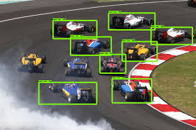


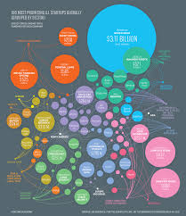
人工智能
你印象中的人工智能？
Notes:
So let’s take a deeper tour of the technology itself
In the past our entire device was just the one engine you see in the middle– that core programmable logic that we invented over 30 years ago ….
Well now that’s just one of multiple engines
First pair of engines you see on the left are the scalar engines, or the Arm processing subsystem– you can see this as the next generation system from our previous SoC products
Note this isn’t a server-class CPU, it does not replace a Xeon processor …
The programmable logic is the “FPGA-Like” engine and based on– in fact the entire device is based on– 7nm TSMC process.
This is the technology we’re best known for and at the center of our adaptability and flexibility.
The last engine on the right is the culmination of Software Programmable, Hardware Adaptable --- the AI Engine
This is the GPU-Like engine that is specialized hardware acceleration for a few functions, AI being one of them, and compiles software code directly,
If you’ve been keeping up with previous announcements, this is what we’ve referred to as the SW/HW programmable engine, because it’s software programmable, and hardware accelerated & adaptable
But Versal’s adaptability is more than processing engines, there are an exceptionally high number of multi-hundred-gigabit protocol engines for key interface.
This is a good reminder that Versal is not just for data center -- Versal is also a high bandwidth, multi-terabit device for the highest end networking applications.
Though there’s much discussion and focus around Data Center, Versal is a multi-market platform,
In Versal we’ve hardened more networking cores than we’ve ever done in the past.

Slide 8

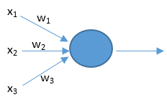
神经网络
大脑神经元到人工神经元
Notes:
So let’s take a deeper tour of the technology itself
In the past our entire device was just the one engine you see in the middle– that core programmable logic that we invented over 30 years ago ….
Well now that’s just one of multiple engines
First pair of engines you see on the left are the scalar engines, or the Arm processing subsystem– you can see this as the next generation system from our previous SoC products
Note this isn’t a server-class CPU, it does not replace a Xeon processor …
The programmable logic is the “FPGA-Like” engine and based on– in fact the entire device is based on– 7nm TSMC process.
This is the technology we’re best known for and at the center of our adaptability and flexibility.
The last engine on the right is the culmination of Software Programmable, Hardware Adaptable --- the AI Engine
This is the GPU-Like engine that is specialized hardware acceleration for a few functions, AI being one of them, and compiles software code directly,
If you’ve been keeping up with previous announcements, this is what we’ve referred to as the SW/HW programmable engine, because it’s software programmable, and hardware accelerated & adaptable
But Versal’s adaptability is more than processing engines, there are an exceptionally high number of multi-hundred-gigabit protocol engines for key interface.
This is a good reminder that Versal is not just for data center -- Versal is also a high bandwidth, multi-terabit device for the highest end networking applications.
Though there’s much discussion and focus around Data Center, Versal is a multi-market platform,
In Versal we’ve hardened more networking cores than we’ve ever done in the past.

Slide 9
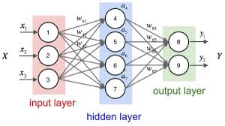
神经网络
Notes:
So let’s take a deeper tour of the technology itself
In the past our entire device was just the one engine you see in the middle– that core programmable logic that we invented over 30 years ago ….
Well now that’s just one of multiple engines
First pair of engines you see on the left are the scalar engines, or the Arm processing subsystem– you can see this as the next generation system from our previous SoC products
Note this isn’t a server-class CPU, it does not replace a Xeon processor …
The programmable logic is the “FPGA-Like” engine and based on– in fact the entire device is based on– 7nm TSMC process.
This is the technology we’re best known for and at the center of our adaptability and flexibility.
The last engine on the right is the culmination of Software Programmable, Hardware Adaptable --- the AI Engine
This is the GPU-Like engine that is specialized hardware acceleration for a few functions, AI being one of them, and compiles software code directly,
If you’ve been keeping up with previous announcements, this is what we’ve referred to as the SW/HW programmable engine, because it’s software programmable, and hardware accelerated & adaptable
But Versal’s adaptability is more than processing engines, there are an exceptionally high number of multi-hundred-gigabit protocol engines for key interface.
This is a good reminder that Versal is not just for data center -- Versal is also a high bandwidth, multi-terabit device for the highest end networking applications.
Though there’s much discussion and focus around Data Center, Versal is a multi-market platform,
In Versal we’ve hardened more networking cores than we’ve ever done in the past.

Slide 10
神经网络
X1:今天的心情指数 X2:电影票价 X3:是否单身
Z > 0:去看电影，Z < 0:不去
z = (x1 * w1 + x2 * w2 + x3 * w3) + b: z = 0.3 * 0.8 + 0.2 * (-0.4) + 1 * (-0.3) + 0.1= -0.14
Notes:
So let’s take a deeper tour of the technology itself
In the past our entire device was just the one engine you see in the middle– that core programmable logic that we invented over 30 years ago ….
Well now that’s just one of multiple engines
First pair of engines you see on the left are the scalar engines, or the Arm processing subsystem– you can see this as the next generation system from our previous SoC products
Note this isn’t a server-class CPU, it does not replace a Xeon processor …
The programmable logic is the “FPGA-Like” engine and based on– in fact the entire device is based on– 7nm TSMC process.
This is the technology we’re best known for and at the center of our adaptability and flexibility.
The last engine on the right is the culmination of Software Programmable, Hardware Adaptable --- the AI Engine
This is the GPU-Like engine that is specialized hardware acceleration for a few functions, AI being one of them, and compiles software code directly,
If you’ve been keeping up with previous announcements, this is what we’ve referred to as the SW/HW programmable engine, because it’s software programmable, and hardware accelerated & adaptable
But Versal’s adaptability is more than processing engines, there are an exceptionally high number of multi-hundred-gigabit protocol engines for key interface.
This is a good reminder that Versal is not just for data center -- Versal is also a high bandwidth, multi-terabit device for the highest end networking applications.
Though there’s much discussion and focus around Data Center, Versal is a multi-market platform,
In Versal we’ve hardened more networking cores than we’ve ever done in the past.

Slide 11
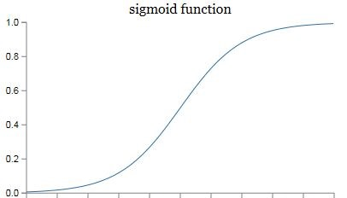
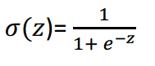
激活函数
把某一个神经元的输出映射到某个区间
思考：如果没有激活函数神经网络会是什么样
Notes:
So let’s take a deeper tour of the technology itself
In the past our entire device was just the one engine you see in the middle– that core programmable logic that we invented over 30 years ago ….
Well now that’s just one of multiple engines
First pair of engines you see on the left are the scalar engines, or the Arm processing subsystem– you can see this as the next generation system from our previous SoC products
Note this isn’t a server-class CPU, it does not replace a Xeon processor …
The programmable logic is the “FPGA-Like” engine and based on– in fact the entire device is based on– 7nm TSMC process.
This is the technology we’re best known for and at the center of our adaptability and flexibility.
The last engine on the right is the culmination of Software Programmable, Hardware Adaptable --- the AI Engine
This is the GPU-Like engine that is specialized hardware acceleration for a few functions, AI being one of them, and compiles software code directly,
If you’ve been keeping up with previous announcements, this is what we’ve referred to as the SW/HW programmable engine, because it’s software programmable, and hardware accelerated & adaptable
But Versal’s adaptability is more than processing engines, there are an exceptionally high number of multi-hundred-gigabit protocol engines for key interface.
This is a good reminder that Versal is not just for data center -- Versal is also a high bandwidth, multi-terabit device for the highest end networking applications.
Though there’s much discussion and focus around Data Center, Versal is a multi-market platform,
In Versal we’ve hardened more networking cores than we’ve ever done in the past.

Slide 12
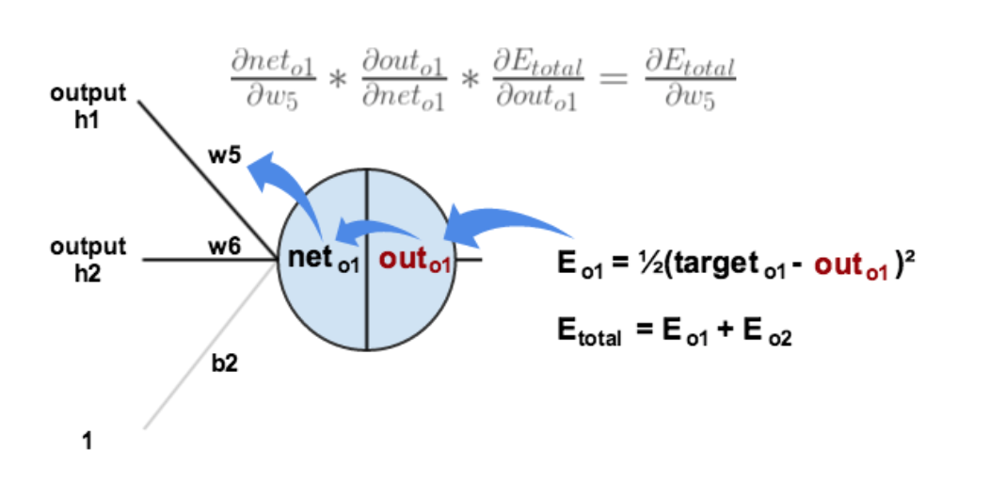
反向传播
反向：
计算误差
隐含层 → 输出层的权值更新
Notes:
So let’s take a deeper tour of the technology itself
In the past our entire device was just the one engine you see in the middle– that core programmable logic that we invented over 30 years ago ….
Well now that’s just one of multiple engines
First pair of engines you see on the left are the scalar engines, or the Arm processing subsystem– you can see this as the next generation system from our previous SoC products
Note this isn’t a server-class CPU, it does not replace a Xeon processor …
The programmable logic is the “FPGA-Like” engine and based on– in fact the entire device is based on– 7nm TSMC process.
This is the technology we’re best known for and at the center of our adaptability and flexibility.
The last engine on the right is the culmination of Software Programmable, Hardware Adaptable --- the AI Engine
This is the GPU-Like engine that is specialized hardware acceleration for a few functions, AI being one of them, and compiles software code directly,
If you’ve been keeping up with previous announcements, this is what we’ve referred to as the SW/HW programmable engine, because it’s software programmable, and hardware accelerated & adaptable
But Versal’s adaptability is more than processing engines, there are an exceptionally high number of multi-hundred-gigabit protocol engines for key interface.
This is a good reminder that Versal is not just for data center -- Versal is also a high bandwidth, multi-terabit device for the highest end networking applications.
Though there’s much discussion and focus around Data Center, Versal is a multi-market platform,
In Versal we’ve hardened more networking cores than we’ve ever done in the past.

Slide 13
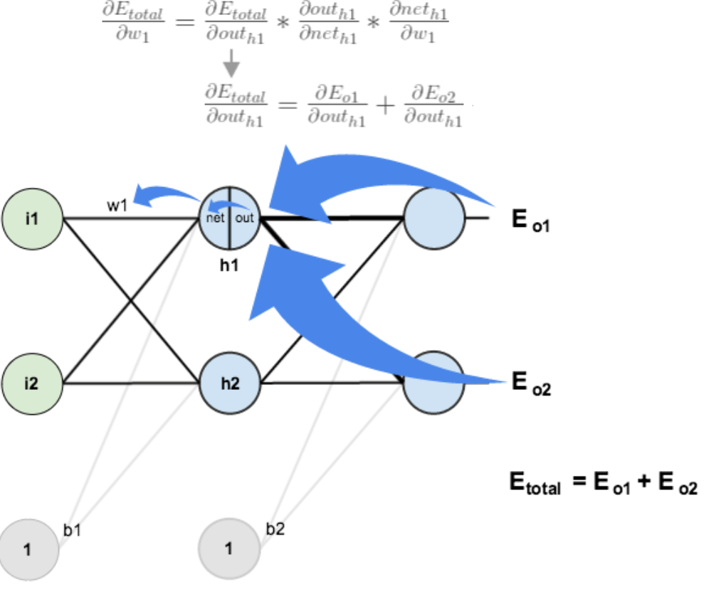
反向传播
反向：
计算误差
隐含层 → 输出层的权值更新
隐含层 → 隐含层的权值更新
Notes:
So let’s take a deeper tour of the technology itself
In the past our entire device was just the one engine you see in the middle– that core programmable logic that we invented over 30 years ago ….
Well now that’s just one of multiple engines
First pair of engines you see on the left are the scalar engines, or the Arm processing subsystem– you can see this as the next generation system from our previous SoC products
Note this isn’t a server-class CPU, it does not replace a Xeon processor …
The programmable logic is the “FPGA-Like” engine and based on– in fact the entire device is based on– 7nm TSMC process.
This is the technology we’re best known for and at the center of our adaptability and flexibility.
The last engine on the right is the culmination of Software Programmable, Hardware Adaptable --- the AI Engine
This is the GPU-Like engine that is specialized hardware acceleration for a few functions, AI being one of them, and compiles software code directly,
If you’ve been keeping up with previous announcements, this is what we’ve referred to as the SW/HW programmable engine, because it’s software programmable, and hardware accelerated & adaptable
But Versal’s adaptability is more than processing engines, there are an exceptionally high number of multi-hundred-gigabit protocol engines for key interface.
This is a good reminder that Versal is not just for data center -- Versal is also a high bandwidth, multi-terabit device for the highest end networking applications.
Though there’s much discussion and focus around Data Center, Versal is a multi-market platform,
In Versal we’ve hardened more networking cores than we’ve ever done in the past.

Slide 14


输入输出
输入：矩阵，向量；图片，音频，统计表…
输出：回归值，分类矩阵，任意数据
对应所要解决的问题
准备训练数据、测试数据
其中数据包含输入数据和标签数据
Notes:
So let’s take a deeper tour of the technology itself
In the past our entire device was just the one engine you see in the middle– that core programmable logic that we invented over 30 years ago ….
Well now that’s just one of multiple engines
First pair of engines you see on the left are the scalar engines, or the Arm processing subsystem– you can see this as the next generation system from our previous SoC products
Note this isn’t a server-class CPU, it does not replace a Xeon processor …
The programmable logic is the “FPGA-Like” engine and based on– in fact the entire device is based on– 7nm TSMC process.
This is the technology we’re best known for and at the center of our adaptability and flexibility.
The last engine on the right is the culmination of Software Programmable, Hardware Adaptable --- the AI Engine
This is the GPU-Like engine that is specialized hardware acceleration for a few functions, AI being one of them, and compiles software code directly,
If you’ve been keeping up with previous announcements, this is what we’ve referred to as the SW/HW programmable engine, because it’s software programmable, and hardware accelerated & adaptable
But Versal’s adaptability is more than processing engines, there are an exceptionally high number of multi-hundred-gigabit protocol engines for key interface.
This is a good reminder that Versal is not just for data center -- Versal is also a high bandwidth, multi-terabit device for the highest end networking applications.
Though there’s much discussion and focus around Data Center, Versal is a multi-market platform,
In Versal we’ve hardened more networking cores than we’ve ever done in the past.

Slide 15
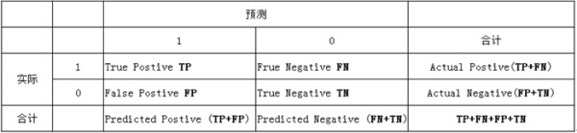
模型评估
(1)若一个实例是正类，但是被预测成为正类，即为真正类(True Postive TP)
(2)若一个实例是负类，但是被预测成为负类，即为真负类(True Negative TN)
(3)若一个实例是负类，但是被预测成为正类，即为假正类(False Postive FP)
(4)若一个实例是正类，但是被预测成为负类，即为假负类(False Negative FN）

Slide 16
模型评估
准确率（正确率）=所有预测正确的样本/总的样本 （TP+TN）/总
精确率= 将正类预测为正类 / 所有预测为正类 TP/（TP+FP）
召回率 = 将正类预测为正类 / 所有正真的正类 TP/（TP+FN）
F值 = 精确率 * 召回率 * 2 / ( 精确率 + 召回率) （F 值即为精确率和召回率的调和平均值）
Notes:
在这里，我以自己的理解，举两个例子，比如公司想找个人当总经理，有一群人来应聘它。我们这时候的目标是，找到的这个人肯定是能够当总经理的，就算有的人看起来像是能当总经理，但是为了确保万无一失，我们要找一个看起来非常非常像能够当总经理的人。这个时候我们当然有着很高的准确率，因为我们找的人几乎肯定是能够当总经理的，但是此时，我们会犯另一个错误，就是有些人确实有能力当总经理，只是我们没有看出来（人不可貌像），所以我们拒绝他，因此我们有低的召回率，这在统计学上被称为犯了第一类错误，即弃真。这样做是合理的，因为即使弃真，但我们保真了。
另一种情况是，比如警察在一群人中想找出几个犯罪的人，这个时候我们就不能要超高的准确率了，因为有可能把真正的犯人放走。找犯人的原则一般是，只要他看起来像个犯人，都应该审查一下，即使最后真像大白后，他真的不是一个犯人。我们平时听到的宁可错杀一千，不可放走一个说的就是这个道理，因此这有着比较低的准确率，但是有高的召回率，这在统计学上被称为犯了第二类错误，即取伪。

Slide 17
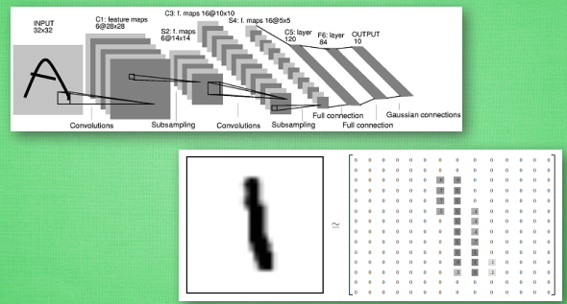
卷积神经网络
卷积神经网络是近些年逐步兴起的一种人工神经网络结构, 因为利用卷积神经网络在图像和语音识别方面能够给出更优预测结果, 这一种技术也被广泛的传播可应用
Notes:
So let’s take a deeper tour of the technology itself
In the past our entire device was just the one engine you see in the middle– that core programmable logic that we invented over 30 years ago ….
Well now that’s just one of multiple engines
First pair of engines you see on the left are the scalar engines, or the Arm processing subsystem– you can see this as the next generation system from our previous SoC products
Note this isn’t a server-class CPU, it does not replace a Xeon processor …
The programmable logic is the “FPGA-Like” engine and based on– in fact the entire device is based on– 7nm TSMC process.
This is the technology we’re best known for and at the center of our adaptability and flexibility.
The last engine on the right is the culmination of Software Programmable, Hardware Adaptable --- the AI Engine
This is the GPU-Like engine that is specialized hardware acceleration for a few functions, AI being one of them, and compiles software code directly,
If you’ve been keeping up with previous announcements, this is what we’ve referred to as the SW/HW programmable engine, because it’s software programmable, and hardware accelerated & adaptable
But Versal’s adaptability is more than processing engines, there are an exceptionally high number of multi-hundred-gigabit protocol engines for key interface.
This is a good reminder that Versal is not just for data center -- Versal is also a high bandwidth, multi-terabit device for the highest end networking applications.
Though there’s much discussion and focus around Data Center, Versal is a multi-market platform,
In Versal we’ve hardened more networking cores than we’ve ever done in the past.

Slide 18
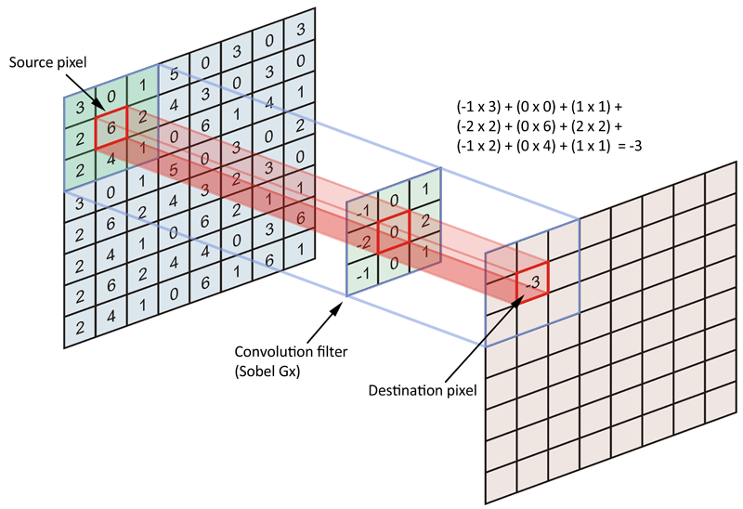
卷积神经网络
将滤波器在图像上滑动，对应位置相乘求和
Notes:
So let’s take a deeper tour of the technology itself
In the past our entire device was just the one engine you see in the middle– that core programmable logic that we invented over 30 years ago ….
Well now that’s just one of multiple engines
First pair of engines you see on the left are the scalar engines, or the Arm processing subsystem– you can see this as the next generation system from our previous SoC products
Note this isn’t a server-class CPU, it does not replace a Xeon processor …
The programmable logic is the “FPGA-Like” engine and based on– in fact the entire device is based on– 7nm TSMC process.
This is the technology we’re best known for and at the center of our adaptability and flexibility.
The last engine on the right is the culmination of Software Programmable, Hardware Adaptable --- the AI Engine
This is the GPU-Like engine that is specialized hardware acceleration for a few functions, AI being one of them, and compiles software code directly,
If you’ve been keeping up with previous announcements, this is what we’ve referred to as the SW/HW programmable engine, because it’s software programmable, and hardware accelerated & adaptable
But Versal’s adaptability is more than processing engines, there are an exceptionally high number of multi-hundred-gigabit protocol engines for key interface.
This is a good reminder that Versal is not just for data center -- Versal is also a high bandwidth, multi-terabit device for the highest end networking applications.
Though there’s much discussion and focus around Data Center, Versal is a multi-market platform,
In Versal we’ve hardened more networking cores than we’ve ever done in the past.

Slide 19
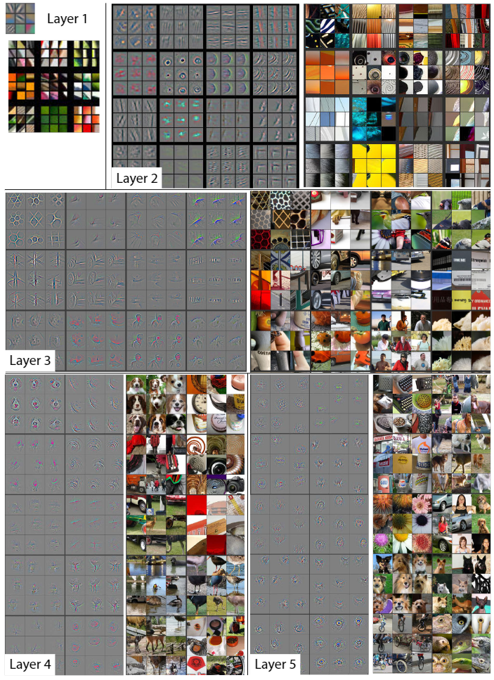
卷积神经网络
多层卷积能抽取复杂特征
卷积神经网络真正使用时，还需要配合池化、激活函数等，以获得更强的表达能力
Notes:
So let’s take a deeper tour of the technology itself
In the past our entire device was just the one engine you see in the middle– that core programmable logic that we invented over 30 years ago ….
Well now that’s just one of multiple engines
First pair of engines you see on the left are the scalar engines, or the Arm processing subsystem– you can see this as the next generation system from our previous SoC products
Note this isn’t a server-class CPU, it does not replace a Xeon processor …
The programmable logic is the “FPGA-Like” engine and based on– in fact the entire device is based on– 7nm TSMC process.
This is the technology we’re best known for and at the center of our adaptability and flexibility.
The last engine on the right is the culmination of Software Programmable, Hardware Adaptable --- the AI Engine
This is the GPU-Like engine that is specialized hardware acceleration for a few functions, AI being one of them, and compiles software code directly,
If you’ve been keeping up with previous announcements, this is what we’ve referred to as the SW/HW programmable engine, because it’s software programmable, and hardware accelerated & adaptable
But Versal’s adaptability is more than processing engines, there are an exceptionally high number of multi-hundred-gigabit protocol engines for key interface.
This is a good reminder that Versal is not just for data center -- Versal is also a high bandwidth, multi-terabit device for the highest end networking applications.
Though there’s much discussion and focus around Data Center, Versal is a multi-market platform,
In Versal we’ve hardened more networking cores than we’ve ever done in the past.

Slide 20
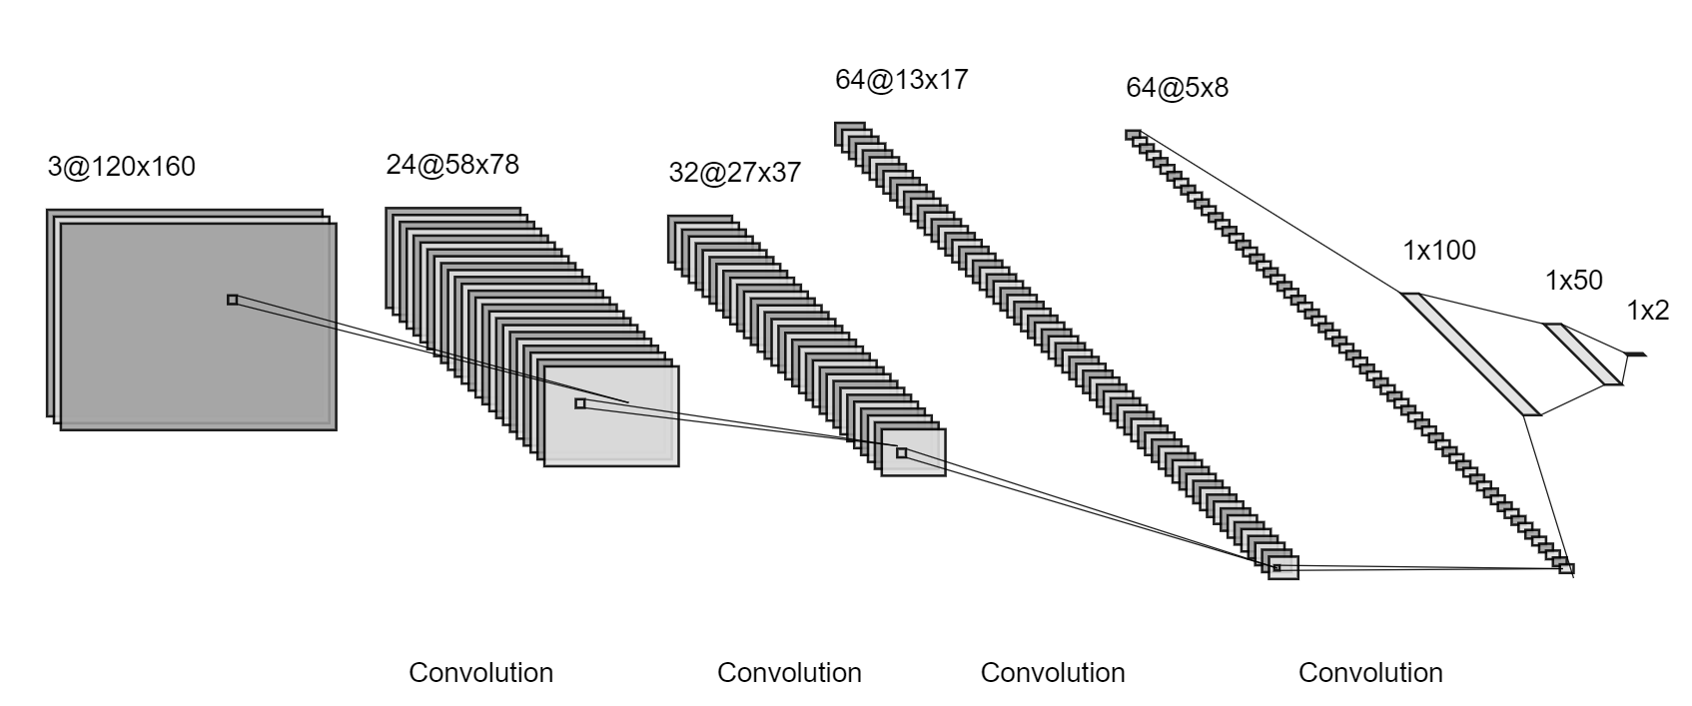
End-to-End模型
输入图像
输出控制指令
Notes:
So let’s take a deeper tour of the technology itself
In the past our entire device was just the one engine you see in the middle– that core programmable logic that we invented over 30 years ago ….
Well now that’s just one of multiple engines
First pair of engines you see on the left are the scalar engines, or the Arm processing subsystem– you can see this as the next generation system from our previous SoC products
Note this isn’t a server-class CPU, it does not replace a Xeon processor …
The programmable logic is the “FPGA-Like” engine and based on– in fact the entire device is based on– 7nm TSMC process.
This is the technology we’re best known for and at the center of our adaptability and flexibility.
The last engine on the right is the culmination of Software Programmable, Hardware Adaptable --- the AI Engine
This is the GPU-Like engine that is specialized hardware acceleration for a few functions, AI being one of them, and compiles software code directly,
If you’ve been keeping up with previous announcements, this is what we’ve referred to as the SW/HW programmable engine, because it’s software programmable, and hardware accelerated & adaptable
But Versal’s adaptability is more than processing engines, there are an exceptionally high number of multi-hundred-gigabit protocol engines for key interface.
This is a good reminder that Versal is not just for data center -- Versal is also a high bandwidth, multi-terabit device for the highest end networking applications.
Though there’s much discussion and focus around Data Center, Versal is a multi-market platform,
In Versal we’ve hardened more networking cores than we’ve ever done in the past.

Slide 21
End-to-End模型
分类模型：输出（0,1,0），代表固定命令
回归模型：输出 0.33，代表偏转角度
Notes:
So let’s take a deeper tour of the technology itself
In the past our entire device was just the one engine you see in the middle– that core programmable logic that we invented over 30 years ago ….
Well now that’s just one of multiple engines
First pair of engines you see on the left are the scalar engines, or the Arm processing subsystem– you can see this as the next generation system from our previous SoC products
Note this isn’t a server-class CPU, it does not replace a Xeon processor …
The programmable logic is the “FPGA-Like” engine and based on– in fact the entire device is based on– 7nm TSMC process.
This is the technology we’re best known for and at the center of our adaptability and flexibility.
The last engine on the right is the culmination of Software Programmable, Hardware Adaptable --- the AI Engine
This is the GPU-Like engine that is specialized hardware acceleration for a few functions, AI being one of them, and compiles software code directly,
If you’ve been keeping up with previous announcements, this is what we’ve referred to as the SW/HW programmable engine, because it’s software programmable, and hardware accelerated & adaptable
But Versal’s adaptability is more than processing engines, there are an exceptionally high number of multi-hundred-gigabit protocol engines for key interface.
This is a good reminder that Versal is not just for data center -- Versal is also a high bandwidth, multi-terabit device for the highest end networking applications.
Though there’s much discussion and focus around Data Center, Versal is a multi-market platform,
In Versal we’ve hardened more networking cores than we’ve ever done in the past.

Slide 22
3. 上手小车

Slide 23
小车一览
Notes:
So let’s take a deeper tour of the technology itself
In the past our entire device was just the one engine you see in the middle– that core programmable logic that we invented over 30 years ago ….
Well now that’s just one of multiple engines
First pair of engines you see on the left are the scalar engines, or the Arm processing subsystem– you can see this as the next generation system from our previous SoC products
Note this isn’t a server-class CPU, it does not replace a Xeon processor …
The programmable logic is the “FPGA-Like” engine and based on– in fact the entire device is based on– 7nm TSMC process.
This is the technology we’re best known for and at the center of our adaptability and flexibility.
The last engine on the right is the culmination of Software Programmable, Hardware Adaptable --- the AI Engine
This is the GPU-Like engine that is specialized hardware acceleration for a few functions, AI being one of them, and compiles software code directly,
If you’ve been keeping up with previous announcements, this is what we’ve referred to as the SW/HW programmable engine, because it’s software programmable, and hardware accelerated & adaptable
But Versal’s adaptability is more than processing engines, there are an exceptionally high number of multi-hundred-gigabit protocol engines for key interface.
This is a good reminder that Versal is not just for data center -- Versal is also a high bandwidth, multi-terabit device for the highest end networking applications.
Though there’s much discussion and focus around Data Center, Versal is a multi-market platform,
In Versal we’ve hardened more networking cores than we’ve ever done in the past.

Slide 24
硬件一览
Notes:
So let’s take a deeper tour of the technology itself
In the past our entire device was just the one engine you see in the middle– that core programmable logic that we invented over 30 years ago ….
Well now that’s just one of multiple engines
First pair of engines you see on the left are the scalar engines, or the Arm processing subsystem– you can see this as the next generation system from our previous SoC products
Note this isn’t a server-class CPU, it does not replace a Xeon processor …
The programmable logic is the “FPGA-Like” engine and based on– in fact the entire device is based on– 7nm TSMC process.
This is the technology we’re best known for and at the center of our adaptability and flexibility.
The last engine on the right is the culmination of Software Programmable, Hardware Adaptable --- the AI Engine
This is the GPU-Like engine that is specialized hardware acceleration for a few functions, AI being one of them, and compiles software code directly,
If you’ve been keeping up with previous announcements, this is what we’ve referred to as the SW/HW programmable engine, because it’s software programmable, and hardware accelerated & adaptable
But Versal’s adaptability is more than processing engines, there are an exceptionally high number of multi-hundred-gigabit protocol engines for key interface.
This is a good reminder that Versal is not just for data center -- Versal is also a high bandwidth, multi-terabit device for the highest end networking applications.
Though there’s much discussion and focus around Data Center, Versal is a multi-market platform,
In Versal we’ve hardened more networking cores than we’ve ever done in the past.

Slide 25
控制API
void throttleSet(float)
void steerSet(float)
void throttleChange(float)
void steerChange(float)
PYNQZ2::Status* getStatus()
string to_record()
链接：
https://github.com/wutianze/pynq_car/blob/master/Pynq-Z2_AD_Car/pynq-guide/collect_guide.md
Notes:
So let’s take a deeper tour of the technology itself
In the past our entire device was just the one engine you see in the middle– that core programmable logic that we invented over 30 years ago ….
Well now that’s just one of multiple engines
First pair of engines you see on the left are the scalar engines, or the Arm processing subsystem– you can see this as the next generation system from our previous SoC products
Note this isn’t a server-class CPU, it does not replace a Xeon processor …
The programmable logic is the “FPGA-Like” engine and based on– in fact the entire device is based on– 7nm TSMC process.
This is the technology we’re best known for and at the center of our adaptability and flexibility.
The last engine on the right is the culmination of Software Programmable, Hardware Adaptable --- the AI Engine
This is the GPU-Like engine that is specialized hardware acceleration for a few functions, AI being one of them, and compiles software code directly,
If you’ve been keeping up with previous announcements, this is what we’ve referred to as the SW/HW programmable engine, because it’s software programmable, and hardware accelerated & adaptable
But Versal’s adaptability is more than processing engines, there are an exceptionally high number of multi-hundred-gigabit protocol engines for key interface.
This is a good reminder that Versal is not just for data center -- Versal is also a high bandwidth, multi-terabit device for the highest end networking applications.
Though there’s much discussion and focus around Data Center, Versal is a multi-market platform,
In Versal we’ve hardened more networking cores than we’ve ever done in the past.

Slide 26
键盘控制
w: move forward
a: turn left
d: turn right
s: stop
t: start to save images
Esc: stop the whole process
Notes:
So let’s take a deeper tour of the technology itself
In the past our entire device was just the one engine you see in the middle– that core programmable logic that we invented over 30 years ago ….
Well now that’s just one of multiple engines
First pair of engines you see on the left are the scalar engines, or the Arm processing subsystem– you can see this as the next generation system from our previous SoC products
Note this isn’t a server-class CPU, it does not replace a Xeon processor …
The programmable logic is the “FPGA-Like” engine and based on– in fact the entire device is based on– 7nm TSMC process.
This is the technology we’re best known for and at the center of our adaptability and flexibility.
The last engine on the right is the culmination of Software Programmable, Hardware Adaptable --- the AI Engine
This is the GPU-Like engine that is specialized hardware acceleration for a few functions, AI being one of them, and compiles software code directly,
If you’ve been keeping up with previous announcements, this is what we’ve referred to as the SW/HW programmable engine, because it’s software programmable, and hardware accelerated & adaptable
But Versal’s adaptability is more than processing engines, there are an exceptionally high number of multi-hundred-gigabit protocol engines for key interface.
This is a good reminder that Versal is not just for data center -- Versal is also a high bandwidth, multi-terabit device for the highest end networking applications.
Though there’s much discussion and focus around Data Center, Versal is a multi-market platform,
In Versal we’ve hardened more networking cores than we’ve ever done in the past.

Slide 27
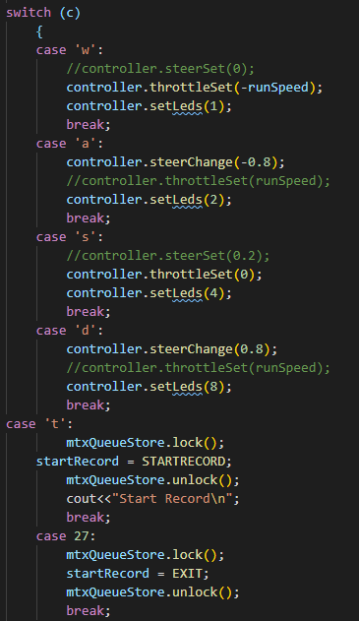
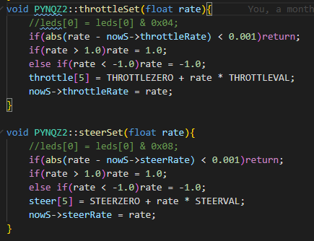
定义自己的键盘控制与小车控制方式
src/control.h,control.cc
src/collect.cc
make collect
Notes:
So let’s take a deeper tour of the technology itself
In the past our entire device was just the one engine you see in the middle– that core programmable logic that we invented over 30 years ago ….
Well now that’s just one of multiple engines
First pair of engines you see on the left are the scalar engines, or the Arm processing subsystem– you can see this as the next generation system from our previous SoC products
Note this isn’t a server-class CPU, it does not replace a Xeon processor …
The programmable logic is the “FPGA-Like” engine and based on– in fact the entire device is based on– 7nm TSMC process.
This is the technology we’re best known for and at the center of our adaptability and flexibility.
The last engine on the right is the culmination of Software Programmable, Hardware Adaptable --- the AI Engine
This is the GPU-Like engine that is specialized hardware acceleration for a few functions, AI being one of them, and compiles software code directly,
If you’ve been keeping up with previous announcements, this is what we’ve referred to as the SW/HW programmable engine, because it’s software programmable, and hardware accelerated & adaptable
But Versal’s adaptability is more than processing engines, there are an exceptionally high number of multi-hundred-gigabit protocol engines for key interface.
This is a good reminder that Versal is not just for data center -- Versal is also a high bandwidth, multi-terabit device for the highest end networking applications.
Though there’s much discussion and focus around Data Center, Versal is a multi-market platform,
In Versal we’ve hardened more networking cores than we’ve ever done in the past.

Slide 28

训练数据采集
Have Fun!
Notes:
So let’s take a deeper tour of the technology itself
In the past our entire device was just the one engine you see in the middle– that core programmable logic that we invented over 30 years ago ….
Well now that’s just one of multiple engines
First pair of engines you see on the left are the scalar engines, or the Arm processing subsystem– you can see this as the next generation system from our previous SoC products
Note this isn’t a server-class CPU, it does not replace a Xeon processor …
The programmable logic is the “FPGA-Like” engine and based on– in fact the entire device is based on– 7nm TSMC process.
This is the technology we’re best known for and at the center of our adaptability and flexibility.
The last engine on the right is the culmination of Software Programmable, Hardware Adaptable --- the AI Engine
This is the GPU-Like engine that is specialized hardware acceleration for a few functions, AI being one of them, and compiles software code directly,
If you’ve been keeping up with previous announcements, this is what we’ve referred to as the SW/HW programmable engine, because it’s software programmable, and hardware accelerated & adaptable
But Versal’s adaptability is more than processing engines, there are an exceptionally high number of multi-hundred-gigabit protocol engines for key interface.
This is a good reminder that Versal is not just for data center -- Versal is also a high bandwidth, multi-terabit device for the highest end networking applications.
Though there’s much discussion and focus around Data Center, Versal is a multi-market platform,
In Versal we’ve hardened more networking cores than we’ve ever done in the past.

Slide 29
4. 数据预处理

Slide 30
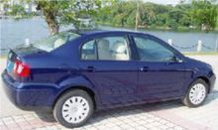

图片预处理
二值化

Slide 31

图片预处理
图片裁剪

Slide 32
图片预处理
归一化 标准化
/255
/255 - 0.5
/127.5 - 1

Slide 33
图片预处理
理解目前的图片预处理代码，尝试修改
In Host-Part/process_img.py :(img[40:,:])/255.0-0.5

Slide 34
5. AI训练框架

Slide 35
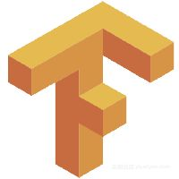
AI训练框架
TensorFlow是由Google Brain team./v开发的开源软件。它用于执行数值计算，也可用于机器学习。

Slide 36

AI训练框架
PyTorch是美国互联网巨头Facebook在深度学习框架Torch的基础上使用Python重写的一个全新的深度学习框架

Slide 37
AI训练框架
Caffe的全称应该是Convolutional Architecture for Fast Feature Embedding，它是一个清晰、高效的深度学习框架

Slide 38
AI训练框架
Keras 是一个用 Python 编写的高级神经网络 API，它能够以 TensorFlow, CNTK, 或者 Theano 作为后端运行。Keras 的开发重点是支持快速的实验。能够以最小的时延把你的想法转换为实验结果，是做好研究的关键。

Slide 39
AI训练框架
阅读代码Host-Part/train.py并查看Keras文档，理解End-to-End网络结构

Slide 40
AI训练框架
设置输入数据目录并开始训练，理解打印参数的意义

Slide 41
AI训练框架
将保存的.h5文件转化为.pb文件

Slide 42
6. DNNDK

Slide 43
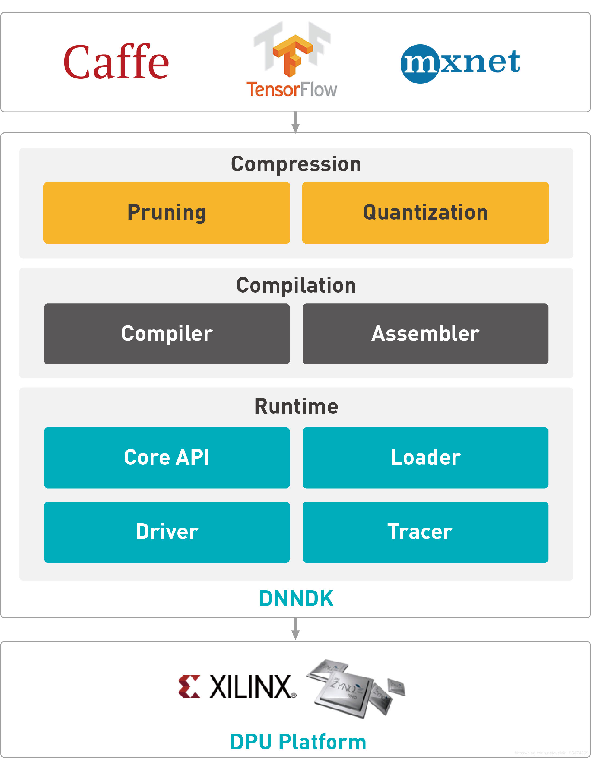
DNNDK组成

Slide 44
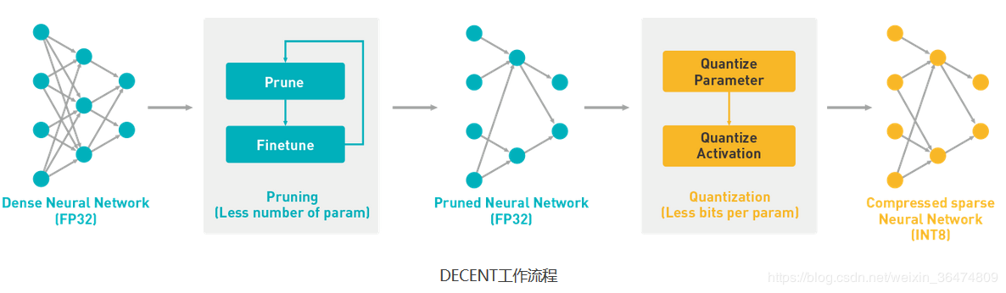
DECENT工具
模型压缩

Slide 45
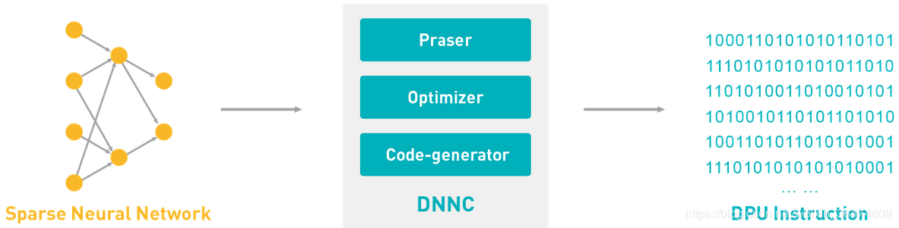
DECENT工具
模型编译
Notes:
编译器前端（ Parser）主要处理网络模型的分析与转换，解析输入网络模型的拓扑结构并将其为 DNNC内部与深度学习框架生成的计算图用IR表示。
中端为优化器 （Optimizer），它基于内部IR实施各种编译优化遍 ，包括融合计算图中不同节点间的操作 、高效调度指令 、充分复用 DPU片上数据等 。
代码生成器 （Code-generator）为DNNC编译后端， 主要负责把经过中端优化后的计算图IR映射成为高效运行在DPU上的指令流 。
————————————————
版权声明：本文为CSDN博主「邢翔瑞」的原创文章，遵循 CC 4.0 BY-SA 版权协议，转载请附上原文出处链接及本声明。
原文链接：https://blog.csdn.net/weixin_36474809/article/details/82585091

Slide 46
DNNDK
在Host端完成压缩和编译
链接：
https://github.com/wutianze/pynq_car/blob/master/Pynq-Z2_AD_Car/pynq-guide/run_guide.md

Slide 47
7. DNNDK with C++

Slide 48
DNNDK
Kernel: 平台上部署的一个深度学习网络模型的实体
Task: DPU Kernel的一个运行实例
Node: DPU上运行网络模型的一个组成部分
Tensor: 多维数据的集合 ，用来存储网络在运行过程中的数据信息
Notes:
4.1 DPU Kernel
将神经网络实现为FPGA上实体（可以看作IPcore）。
DPU Kernel可以理解为在DPU平台上部署的平台上部署的一个深度学习网络模型的实 体。每个神经网络对应 一个 DPU汇编文件，通过调用DPU运行N2Cube时的dpuLoadKernel()成为一个可运行实体。 DPU的运行时将其加载到特定内存空间并为其分配硬件资源。 然后通过调用 dpuCreateTask()将其实例化为多个DPU Task。
4.2 DPU Task
DPU Task是 DPU Kernel的一个运行实例 。每个 DPU Task中处理一个具体的计算任务。 每个 DPU Task之间的内存空间相互独立，使得我们可以通过多线程来运行多个 DPU Task，以此来提高系统效率和吞吐量 。
4.3 DPU Node
DPU Node是DPU上运行网络模型的一个组成部分 。每个 DPU Node都有其对应的输入、出以及其对应的输入、出以及相关参数。 DPU Node依靠其名称来索引，我们可以依靠其名称来索引，我们可以通过 DNNDK提供的 API来获取每个 Node的相关信息 的相关信息 。
4.4 DPU Tensor
DPU Tensor是多维数据的集合 ，用来存储网络在运行过程中的数据信息。 我们可以通过DNNDK提供的 API获取某个 Tensor对应的属性，如 Height， Width，Channel以及地址信息。
————————————————
版权声明：本文为CSDN博主「邢翔瑞」的原创文章，遵循 CC 4.0 BY-SA 版权协议，转载请附上原文出处链接及本声明。
原文链接：https://blog.csdn.net/weixin_36474809/article/details/82585091

Slide 49
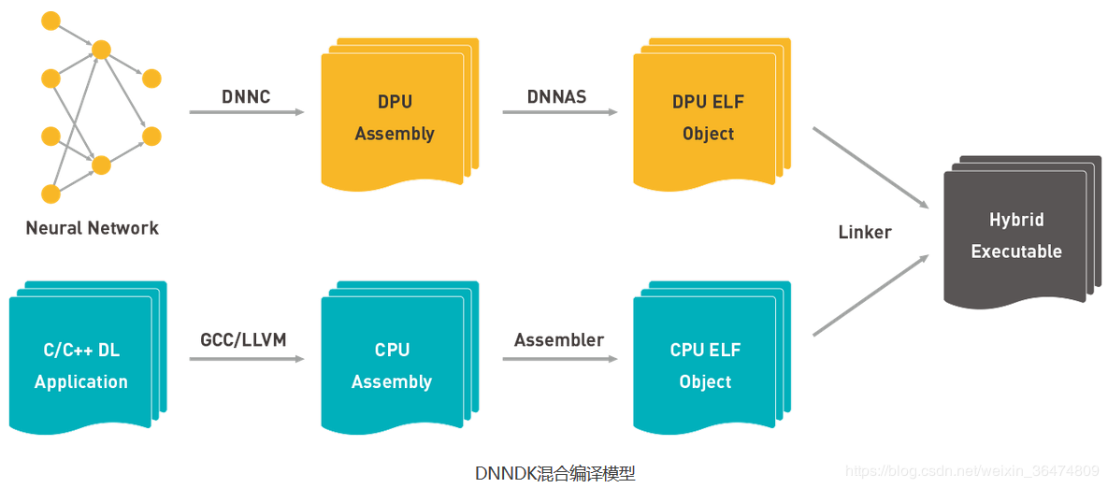
DNNDK
混合编译

Slide 50
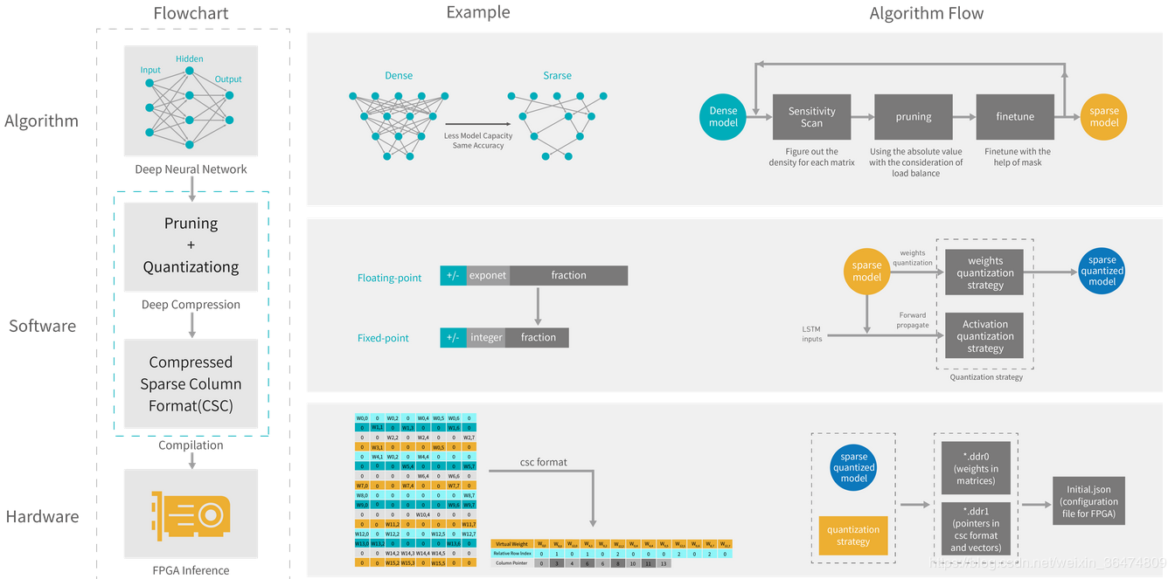
DNNDK
运行
Notes:
DPU运行时主要包含四部分：加载器 （Loader）、性能 、性能分析器（ Profiler）、库（ Library）和 DPU驱动（ DPU Driver）。

Slide 51
DNNDK
- Call `dpuOpen()` to open the DPU device.
- Call `dpuLoadKernel()` to load the DPU kernel reset50_0.
- Call `dpuCreateTask()` to create task for each DPU kernel.
- Call `dpuDestroyKernel()` and `dpuDestroyTask()` to destroy DPU kernel and task.
- Call `dpuClose()` to close the DPU device.
Notes:
4.1 DPU Kernel
将神经网络实现为FPGA上实体（可以看作IPcore）。
DPU Kernel可以理解为在DPU平台上部署的平台上部署的一个深度学习网络模型的实 体。每个神经网络对应 一个 DPU汇编文件，通过调用DPU运行N2Cube时的dpuLoadKernel()成为一个可运行实体。 DPU的运行时将其加载到特定内存空间并为其分配硬件资源。 然后通过调用 dpuCreateTask()将其实例化为多个DPU Task。
4.2 DPU Task
DPU Task是 DPU Kernel的一个运行实例 。每个 DPU Task中处理一个具体的计算任务。 每个 DPU Task之间的内存空间相互独立，使得我们可以通过多线程来运行多个 DPU Task，以此来提高系统效率和吞吐量 。
4.3 DPU Node
DPU Node是DPU上运行网络模型的一个组成部分 。每个 DPU Node都有其对应的输入、出以及其对应的输入、出以及相关参数。 DPU Node依靠其名称来索引，我们可以依靠其名称来索引，我们可以通过 DNNDK提供的 API来获取每个 Node的相关信息 的相关信息 。
4.4 DPU Tensor
DPU Tensor是多维数据的集合 ，用来存储网络在运行过程中的数据信息。 我们可以通过DNNDK提供的 API获取某个 Tensor对应的属性，如 Height， Width，Channel以及地址信息。
————————————————
版权声明：本文为CSDN博主「邢翔瑞」的原创文章，遵循 CC 4.0 BY-SA 版权协议，转载请附上原文出处链接及本声明。
原文链接：https://blog.csdn.net/weixin_36474809/article/details/82585091

Slide 52
DNNDK
- Get the image for processing and set it as input
- Run the task using `dpuRunTask()`
- Get the output of the kernel and Run Softmax in it if needed
- If your model is regression model, you can just use the result without running softmax like
Notes:
4.1 DPU Kernel
将神经网络实现为FPGA上实体（可以看作IPcore）。
DPU Kernel可以理解为在DPU平台上部署的平台上部署的一个深度学习网络模型的实 体。每个神经网络对应 一个 DPU汇编文件，通过调用DPU运行N2Cube时的dpuLoadKernel()成为一个可运行实体。 DPU的运行时将其加载到特定内存空间并为其分配硬件资源。 然后通过调用 dpuCreateTask()将其实例化为多个DPU Task。
4.2 DPU Task
DPU Task是 DPU Kernel的一个运行实例 。每个 DPU Task中处理一个具体的计算任务。 每个 DPU Task之间的内存空间相互独立，使得我们可以通过多线程来运行多个 DPU Task，以此来提高系统效率和吞吐量 。
4.3 DPU Node
DPU Node是DPU上运行网络模型的一个组成部分 。每个 DPU Node都有其对应的输入、出以及其对应的输入、出以及相关参数。 DPU Node依靠其名称来索引，我们可以依靠其名称来索引，我们可以通过 DNNDK提供的 API来获取每个 Node的相关信息 的相关信息 。
4.4 DPU Tensor
DPU Tensor是多维数据的集合 ，用来存储网络在运行过程中的数据信息。 我们可以通过DNNDK提供的 API获取某个 Tensor对应的属性，如 Height， Width，Channel以及地址信息。
————————————————
版权声明：本文为CSDN博主「邢翔瑞」的原创文章，遵循 CC 4.0 BY-SA 版权协议，转载请附上原文出处链接及本声明。
原文链接：https://blog.csdn.net/weixin_36474809/article/details/82585091

Slide 53
DNNDK
阅读Pynq-Part/Car/src/run.cc，尝试根据自己的需求修改DPU调用函数并运行
Notice: insmod dpu.ko
Notes:
4.1 DPU Kernel
将神经网络实现为FPGA上实体（可以看作IPcore）。
DPU Kernel可以理解为在DPU平台上部署的平台上部署的一个深度学习网络模型的实 体。每个神经网络对应 一个 DPU汇编文件，通过调用DPU运行N2Cube时的dpuLoadKernel()成为一个可运行实体。 DPU的运行时将其加载到特定内存空间并为其分配硬件资源。 然后通过调用 dpuCreateTask()将其实例化为多个DPU Task。
4.2 DPU Task
DPU Task是 DPU Kernel的一个运行实例 。每个 DPU Task中处理一个具体的计算任务。 每个 DPU Task之间的内存空间相互独立，使得我们可以通过多线程来运行多个 DPU Task，以此来提高系统效率和吞吐量 。
4.3 DPU Node
DPU Node是DPU上运行网络模型的一个组成部分 。每个 DPU Node都有其对应的输入、出以及其对应的输入、出以及相关参数。 DPU Node依靠其名称来索引，我们可以依靠其名称来索引，我们可以通过 DNNDK提供的 API来获取每个 Node的相关信息 的相关信息 。
4.4 DPU Tensor
DPU Tensor是多维数据的集合 ，用来存储网络在运行过程中的数据信息。 我们可以通过DNNDK提供的 API获取某个 Tensor对应的属性，如 Height， Width，Channel以及地址信息。
————————————————
版权声明：本文为CSDN博主「邢翔瑞」的原创文章，遵循 CC 4.0 BY-SA 版权协议，转载请附上原文出处链接及本声明。
原文链接：https://blog.csdn.net/weixin_36474809/article/details/82585091

Slide 54
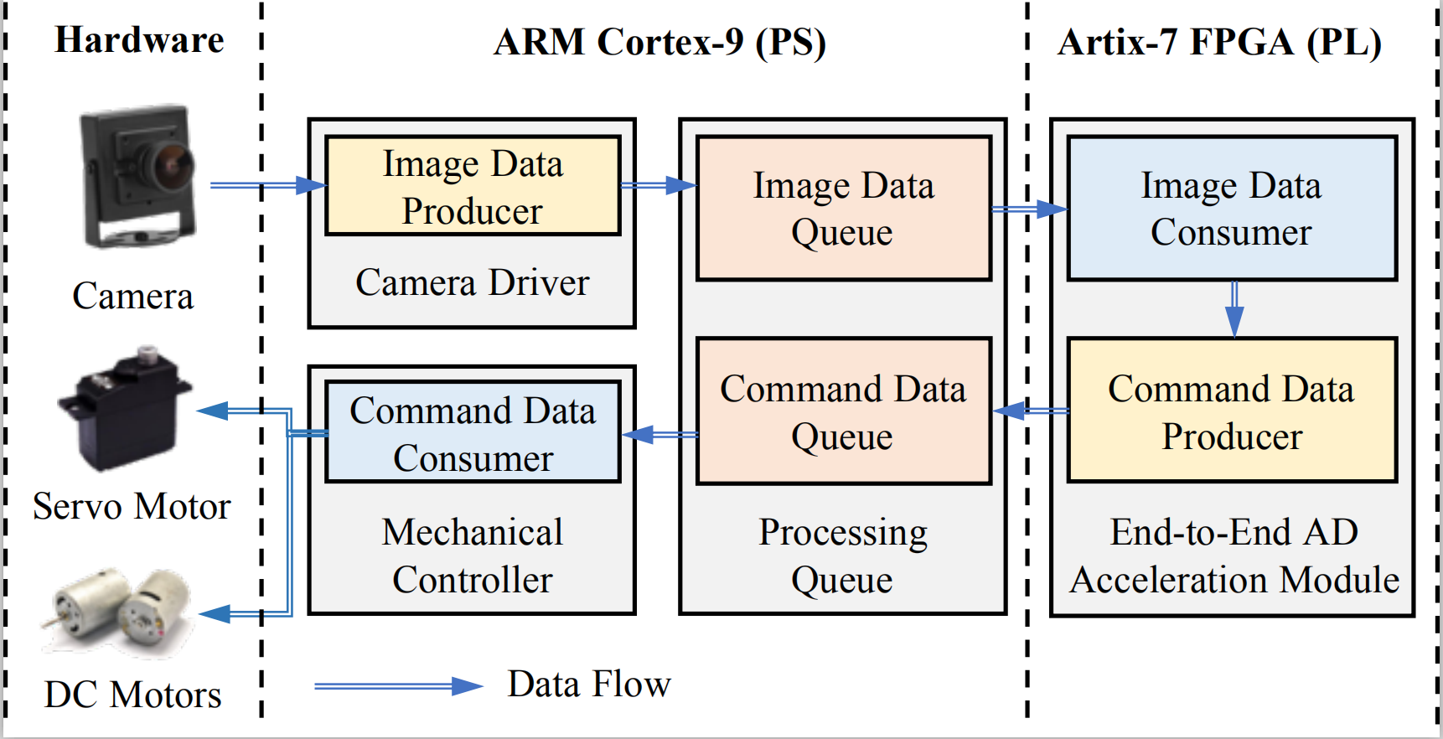
DNNDK
setInputImage需要根据之前的图片预处理方法来修改
理解run.cc运行过程并编译
尝试运行可执行文件，观察输出与小车行为
Notes:
4.1 DPU Kernel
将神经网络实现为FPGA上实体（可以看作IPcore）。
DPU Kernel可以理解为在DPU平台上部署的平台上部署的一个深度学习网络模型的实 体。每个神经网络对应 一个 DPU汇编文件，通过调用DPU运行N2Cube时的dpuLoadKernel()成为一个可运行实体。 DPU的运行时将其加载到特定内存空间并为其分配硬件资源。 然后通过调用 dpuCreateTask()将其实例化为多个DPU Task。
4.2 DPU Task
DPU Task是 DPU Kernel的一个运行实例 。每个 DPU Task中处理一个具体的计算任务。 每个 DPU Task之间的内存空间相互独立，使得我们可以通过多线程来运行多个 DPU Task，以此来提高系统效率和吞吐量 。
4.3 DPU Node
DPU Node是DPU上运行网络模型的一个组成部分 。每个 DPU Node都有其对应的输入、出以及其对应的输入、出以及相关参数。 DPU Node依靠其名称来索引，我们可以依靠其名称来索引，我们可以通过 DNNDK提供的 API来获取每个 Node的相关信息 的相关信息 。
4.4 DPU Tensor
DPU Tensor是多维数据的集合 ，用来存储网络在运行过程中的数据信息。 我们可以通过DNNDK提供的 API获取某个 Tensor对应的属性，如 Height， Width，Channel以及地址信息。
————————————————
版权声明：本文为CSDN博主「邢翔瑞」的原创文章，遵循 CC 4.0 BY-SA 版权协议，转载请附上原文出处链接及本声明。
原文链接：https://blog.csdn.net/weixin_36474809/article/details/82585091

Slide 55
Inference
Have Fun!

Slide 56
8. 模型优化

Slide 57
模型优化
1. 训练数据质量
2. 训练参数调整
3. 预处理合理性
4. 网络结构
5. 测试环境
6. 计算平台性能等其他原因
Notes:
4.1 DPU Kernel
将神经网络实现为FPGA上实体（可以看作IPcore）。
DPU Kernel可以理解为在DPU平台上部署的平台上部署的一个深度学习网络模型的实 体。每个神经网络对应 一个 DPU汇编文件，通过调用DPU运行N2Cube时的dpuLoadKernel()成为一个可运行实体。 DPU的运行时将其加载到特定内存空间并为其分配硬件资源。 然后通过调用 dpuCreateTask()将其实例化为多个DPU Task。
4.2 DPU Task
DPU Task是 DPU Kernel的一个运行实例 。每个 DPU Task中处理一个具体的计算任务。 每个 DPU Task之间的内存空间相互独立，使得我们可以通过多线程来运行多个 DPU Task，以此来提高系统效率和吞吐量 。
4.3 DPU Node
DPU Node是DPU上运行网络模型的一个组成部分 。每个 DPU Node都有其对应的输入、出以及其对应的输入、出以及相关参数。 DPU Node依靠其名称来索引，我们可以依靠其名称来索引，我们可以通过 DNNDK提供的 API来获取每个 Node的相关信息 的相关信息 。
4.4 DPU Tensor
DPU Tensor是多维数据的集合 ，用来存储网络在运行过程中的数据信息。 我们可以通过DNNDK提供的 API获取某个 Tensor对应的属性，如 Height， Width，Channel以及地址信息。
————————————————
版权声明：本文为CSDN博主「邢翔瑞」的原创文章，遵循 CC 4.0 BY-SA 版权协议，转载请附上原文出处链接及本声明。
原文链接：https://blog.csdn.net/weixin_36474809/article/details/82585091

Slide 58
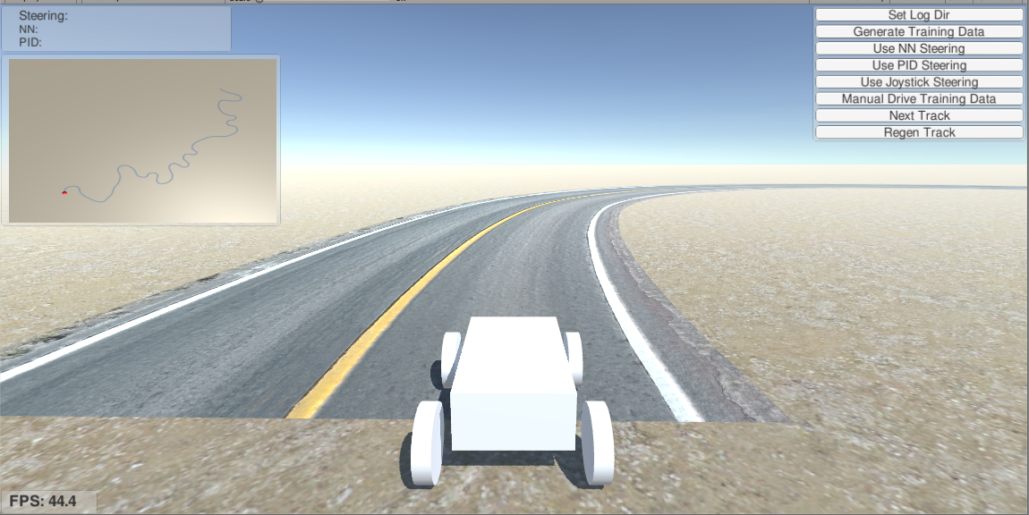
辅助工具
模拟器
详情参考：
https://github.com/wutianze/pynq_car/tree/master/Pynq-Z2_AD_Car/virtual-guide

Slide 59
炼丹
Have Fun!

Slide 60
9. 经典案例

Slide 61
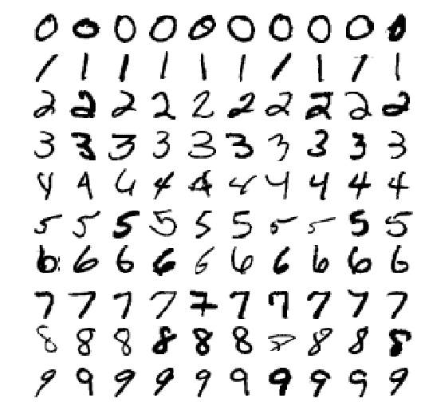
分类-MNIST（手写数字识别）
Tensorflow 入门经典案例，AI界的Hello World

Slide 62

分类-MNIST（手写数字识别）
步骤：
MNIST数据集下载
Tensorflow训练
DNNDK优化编译
Pynq-Z2运行

Slide 63
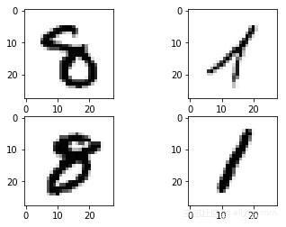
分类-MNIST（手写数字识别）
Have Fun!
链接：
https://github.com/wutianze/dnndk-pynqz2/tree/master/mnist_tf

Slide 64
Thank you

